Slide 1
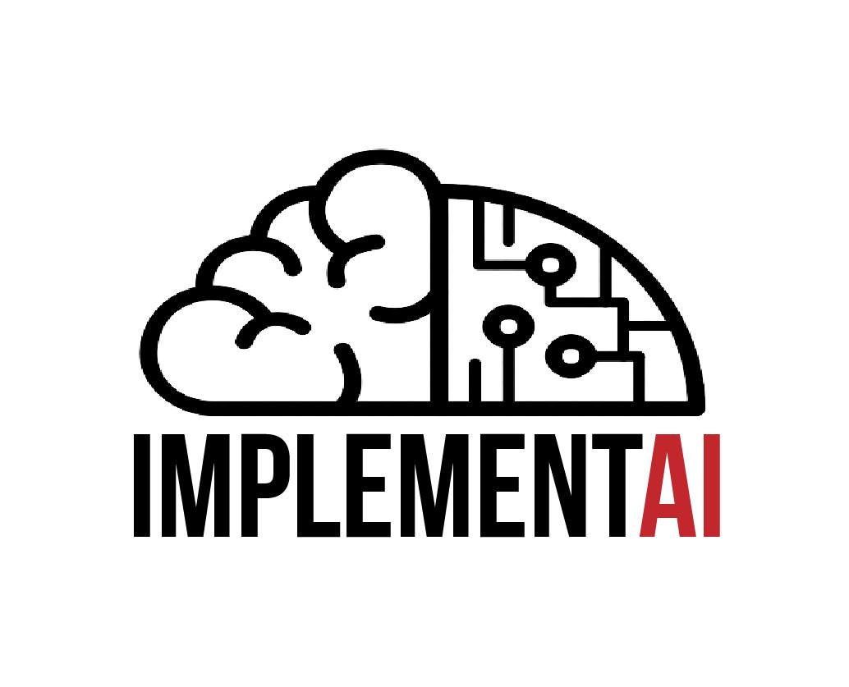

DeLEG: Deep Learning for EpiGenomics data to predict phenotype.
Deep Learning
Epigenomics

Slide 2
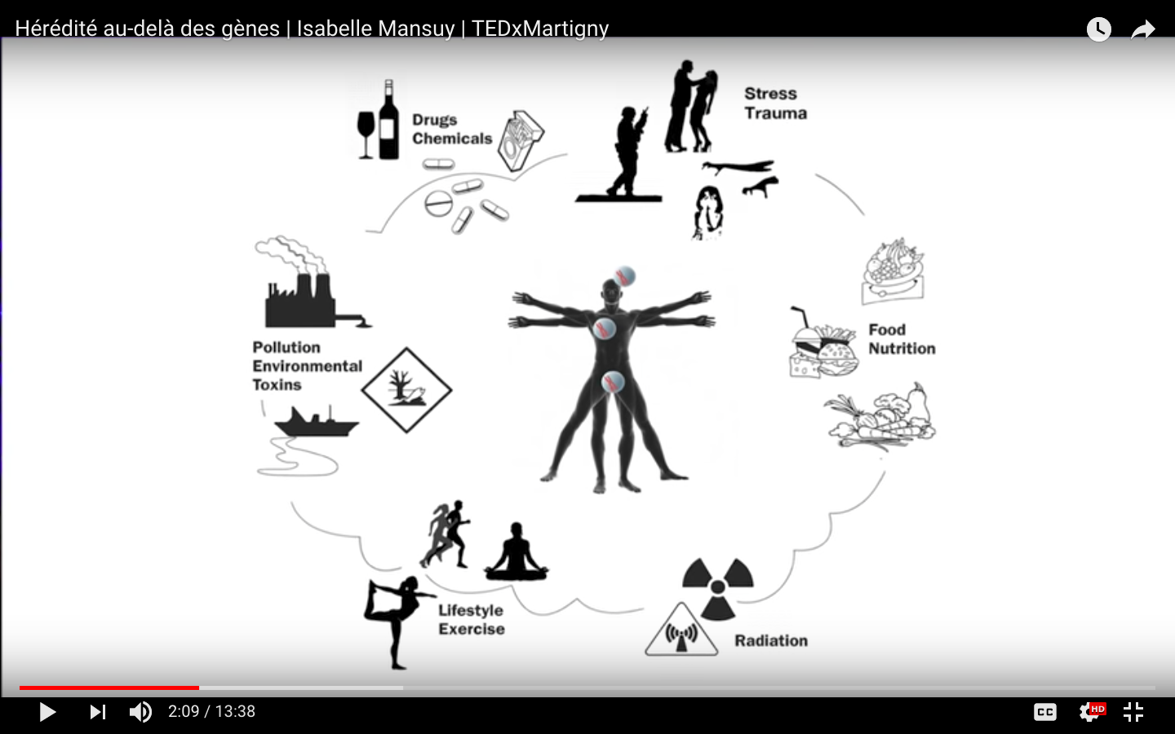
Phenotype, genotype and environment
Phenotype = genotype + environment
P = G + E
Interaction between genetics and environmental factors
P = f(G,E)

Slide 3
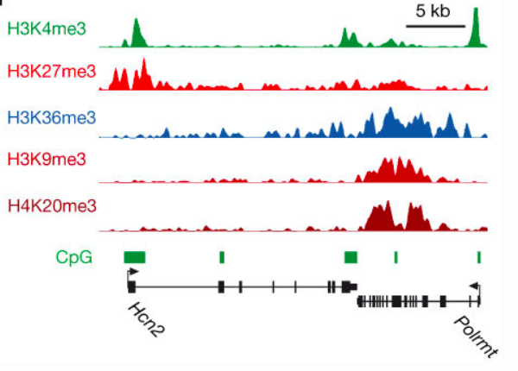
Challenges
Finding “important” regions in ChIP-seq data
Using the “important” regions for prediction, classification and better understanding of Human Epigenome
HEADLINE:
Ground truth: “Healthy” and “Disease”
Training set: 14 subjects in each phenotype
Validating set: 4 subjects in each phenotype
Testing set: Any new subject not in the set of 36 subjects
doi:10.1038/nature06008

Slide 4
Workflow
Otsu thresholding for segmentation
Enrichment score of window around TSS
Train a Conv Neural Network for classification
Input: ChIP-seq data
Output: “Important” regions of the ChIP-seq data corresponding to peaks
Detailed Method: Otsu thresholding of the ChIP-seq data to remove background and filter out peaks. A post-processing for noise removal is done following thresholding.
Input: ChIP-seq data and peak regions
Output: Enrichment score from ChIP-seq data of each bp around TSS for each gene corresponding to peaks
Detailed Method: Gene identification from database and window extraction (data manipulation process)
Input: Enrichment score of fixed length sequences
Output: Classification probabilities for the window to lie in each phenotype.
Detailed Method: Training a CNN with windows from 14 subjects in each class, totalling to about 20k windows in each class. Looking back at the learned features -> further insight

Slide 5


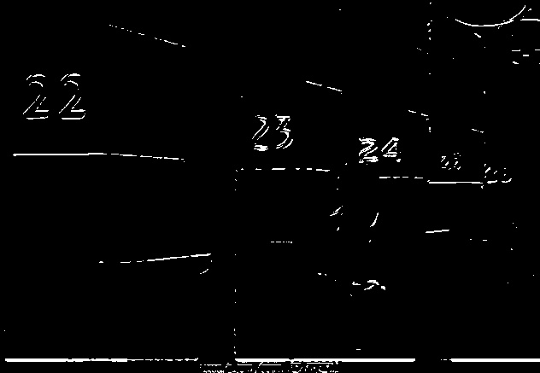
Learning attention from classification data
“ Those who pay attention learn, Those who don’t cram ”
Use Global Average Pooling concept to learn regions in input which caused the network to classify it to a particular class
Final layer filters know where to look
Get defining regions - define further research!!

Slide 6
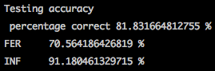
Supplementary Material Results

Slide 7
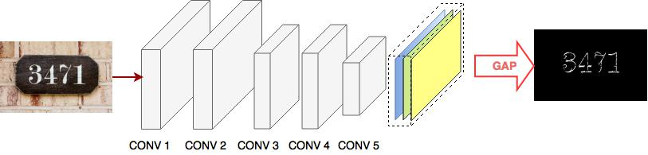
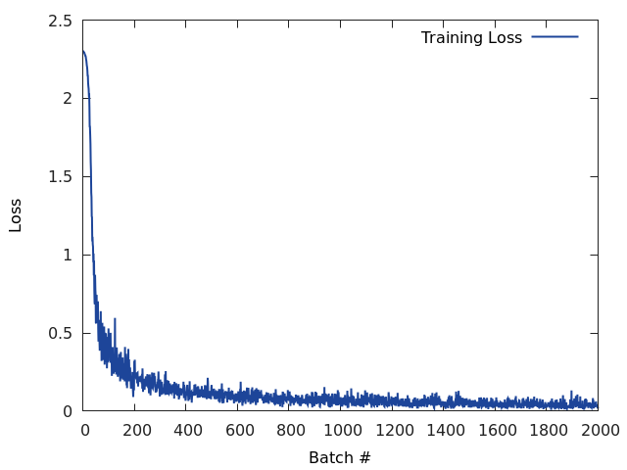
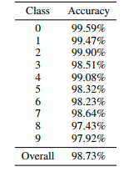
Supplementary material - Results

